Slide 1
TERM PROJECT GROUP 4
Jesus CortezBonilla
Kevin De LA Torre
Joshua Rowill Koa
Bryan Mendoza
Samuel Mendoza

Slide 2
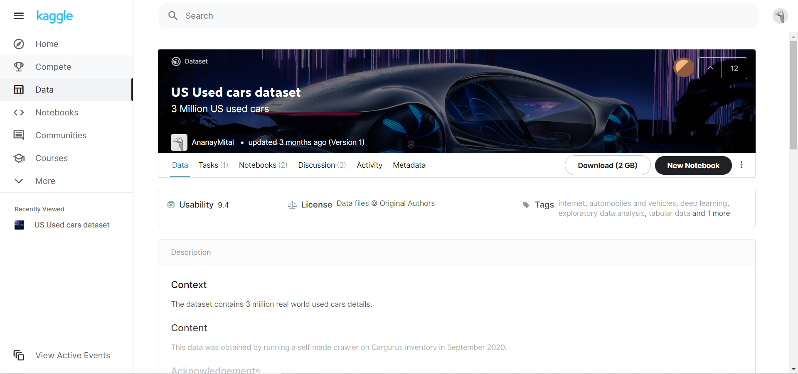
Dataset Location
https://www.kaggle.com/ananaymital/us-used-cars-dataset
FILE SIZE
COMPRESSED: 2 GB
UNCOMPRESSED: 9.29GB

Slide 3
Overview
Create queries and analyze results to help identify deals in the market and guide your buying decision.
Get the actual predicted value for each car and types of cars on sale within 25 cities.
Identify ‘overpriced’ cars to try to possibly haggle dealers down.
Classify cars based on mileage, brand, and days on the market.
Use queries to evaluate dealers who will generate the most savings.

Slide 4
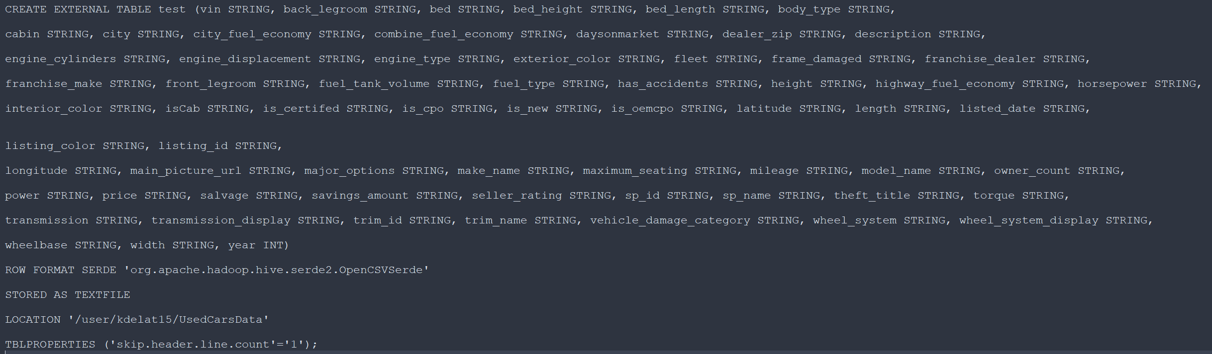
Overview (CONT)
Dataset has 66 columns and over 3 million entries
Create Table Statement (0.445 seconds)

Slide 5



Oracle big data service
EMR CLUSTER: 3 NODES
VERSION: 20.3.3-20
12 OCPUs
Memory: 180GB
Storage: 957GB
Applications: Hive, Tableau, PowerBi

Slide 6
Flowchart for data analysis
Downloaded Data From:
https://www.kaggle.com/ananaymital/us-used-cars-dataset
Upload file using WINSCP
Uncompressed zip file
Created tables in Hive based on CSV file
Move Data into Hadoop Distribution File System
Output Results and various csv files
Copied various csv files on to Desktop
Created visualizations based on csv files in Tableau/SAP Analytic Cloud

Slide 7
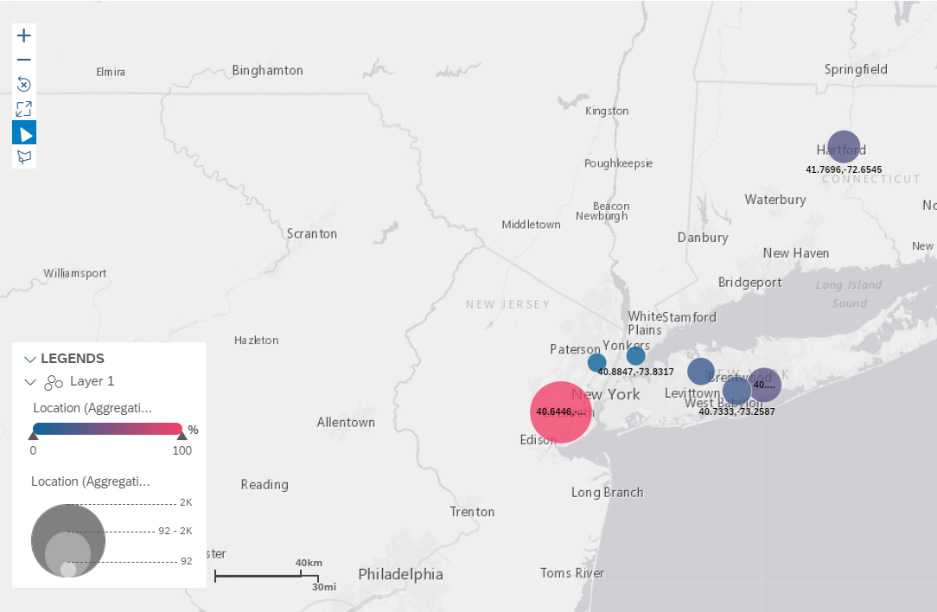
Geo Spatial Visualization
AVERAGE DAYS ON MARKET
LINDEN: 297.93
BOHEMIA: 166.98
HARTFORD 158.48
WOODBURY 132.57
BAYSHORE: 140
BRONX: 92.60
LITTLE FERRY: 91.72

Slide 8
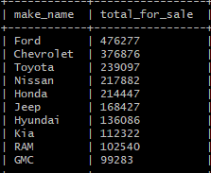
Top 10 Car Brands Being Sold
10 rows, 270.319 seconds = 4 mins 50 seconds

Slide 9
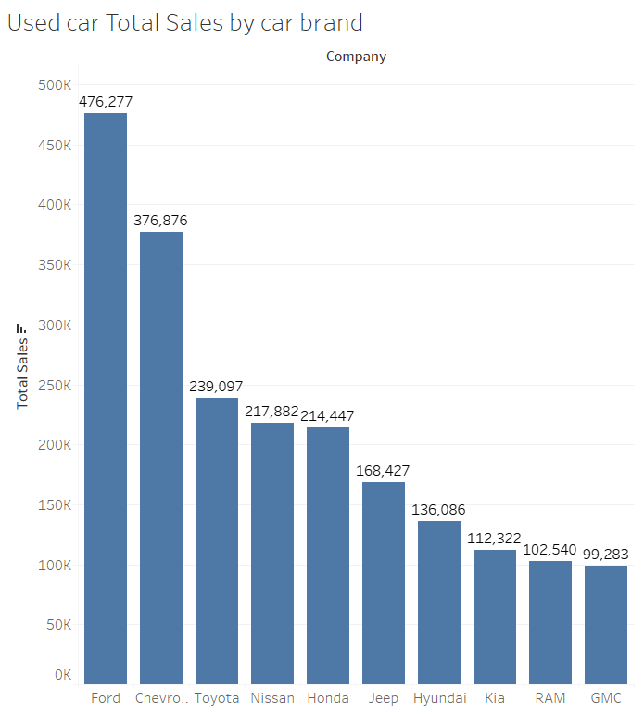
Top 10 Car Brands for Sale
Most for Sale are Ford followed by Chevy
Toyota, Nissan & Honda all follow one another closely
More RAMs for sale rather than Dodge

Slide 10
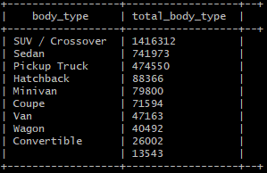
Types of Cars Being Sold
10 rows, 252.162 seconds = 4 mins 20 seconds

Slide 11
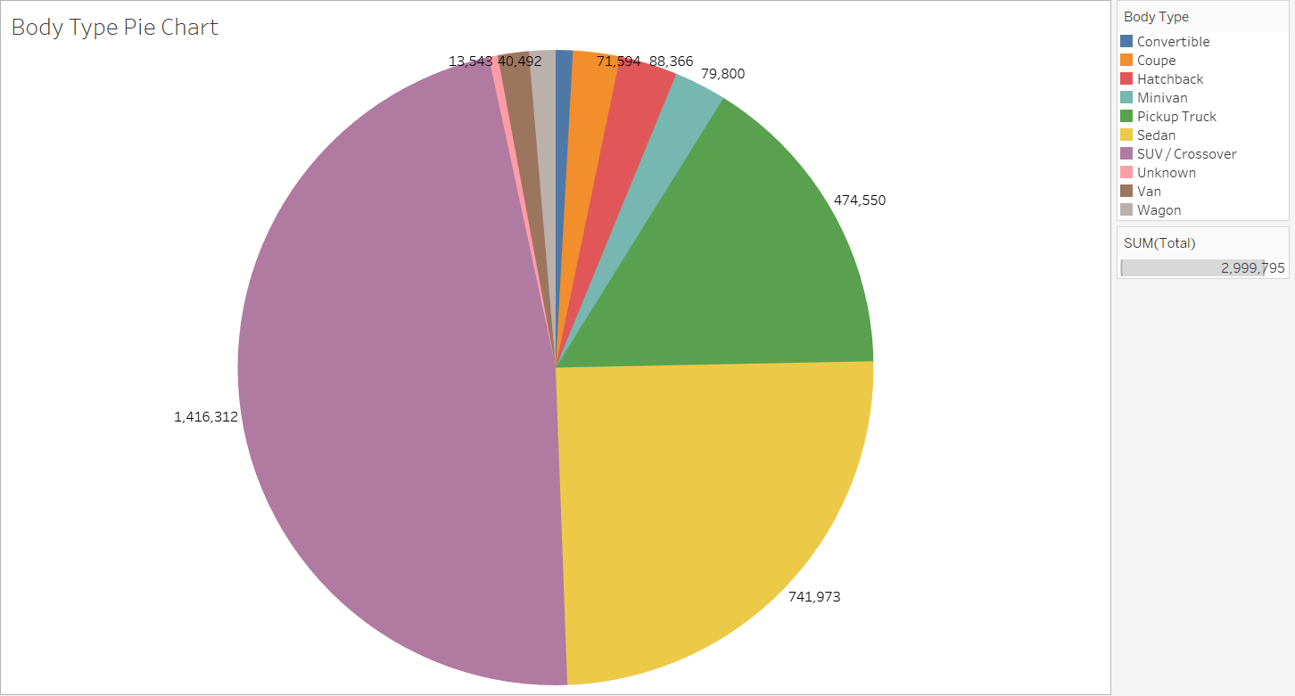
Types/Body Types Being Sold

Slide 12
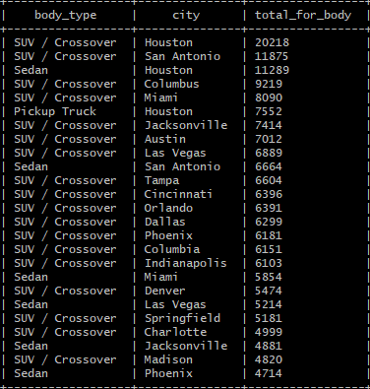
Top Car Type for Sale in 25 Cities
25 rows, 280 seconds = 4 min and 66 seconds

Slide 13
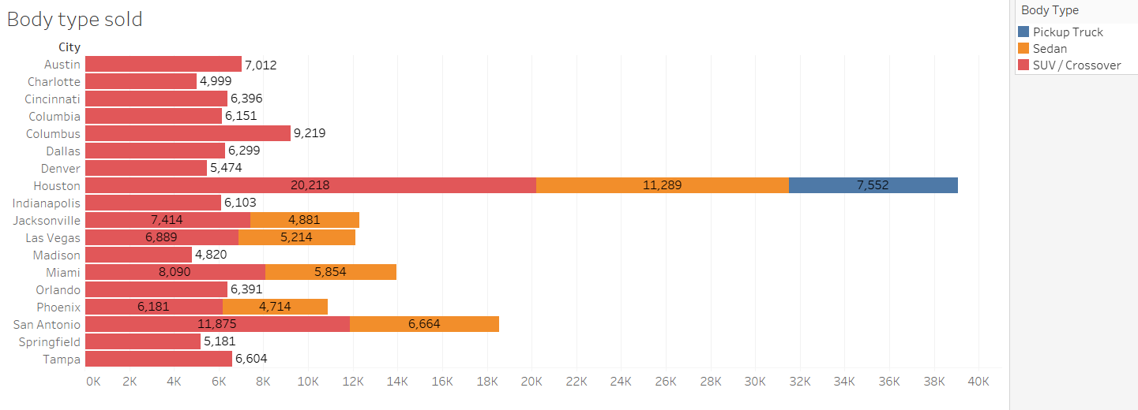

Slide 14
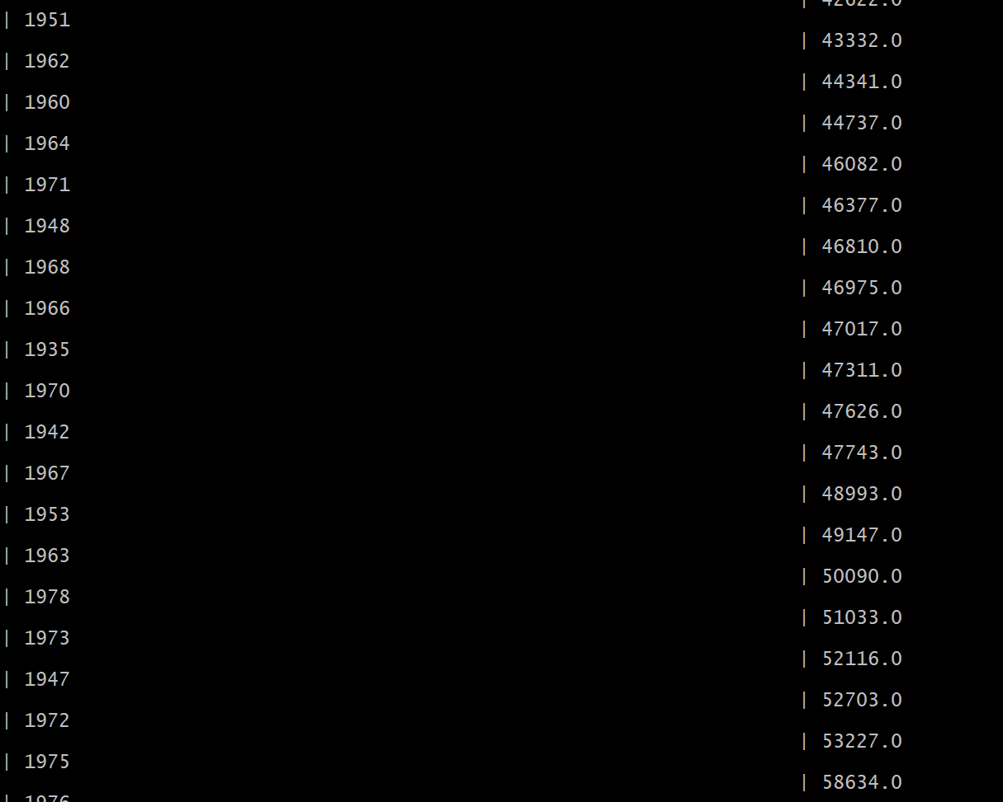
AVERAGE MILEAGE OF CARs BY YEAR
106 rows selected (287.12 seconds) = 4.7 minutes

Slide 15
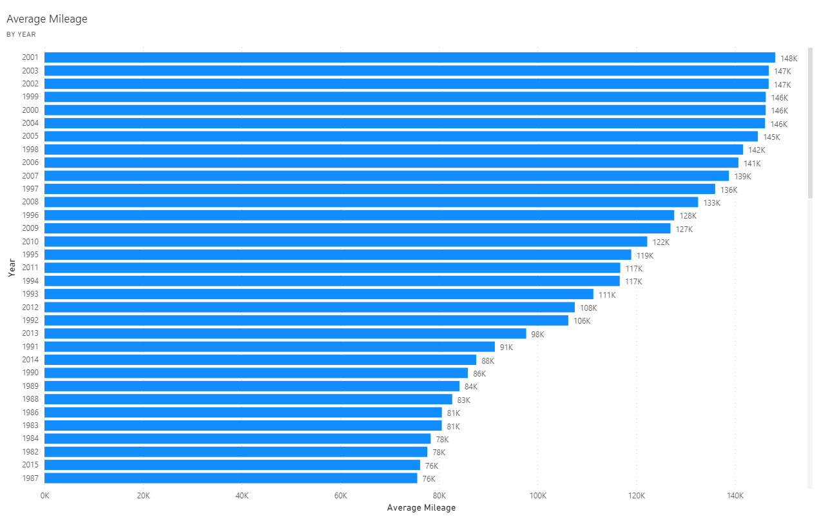
AVERAGE MILEAGE BY YEAR (CONT.)

Slide 16
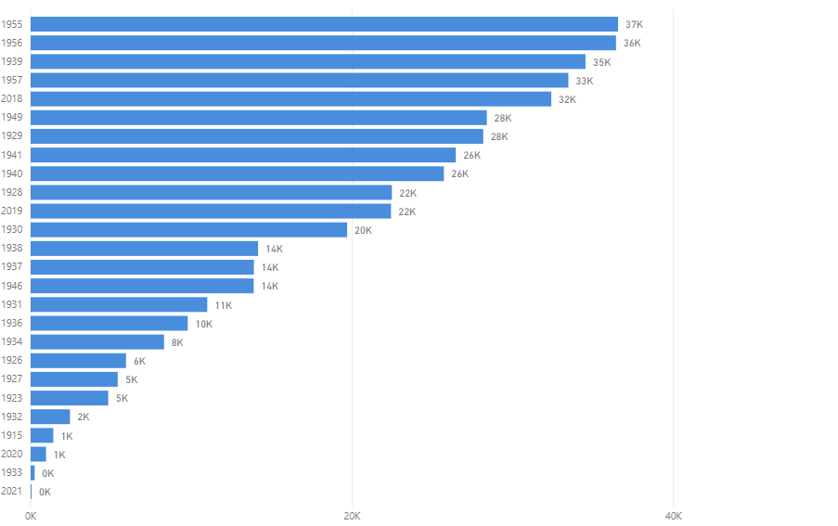
Average Mileage BY year

Slide 17
AVERAGE MILEAGE BY YEAR
HIGHEST MILEAGE
Lowest mileage
- 2001 (148,197)
- 2003 (146,899)
- 2002 (146,868)
-2021 (18)
1933 (250)
2020 (958)

Slide 18
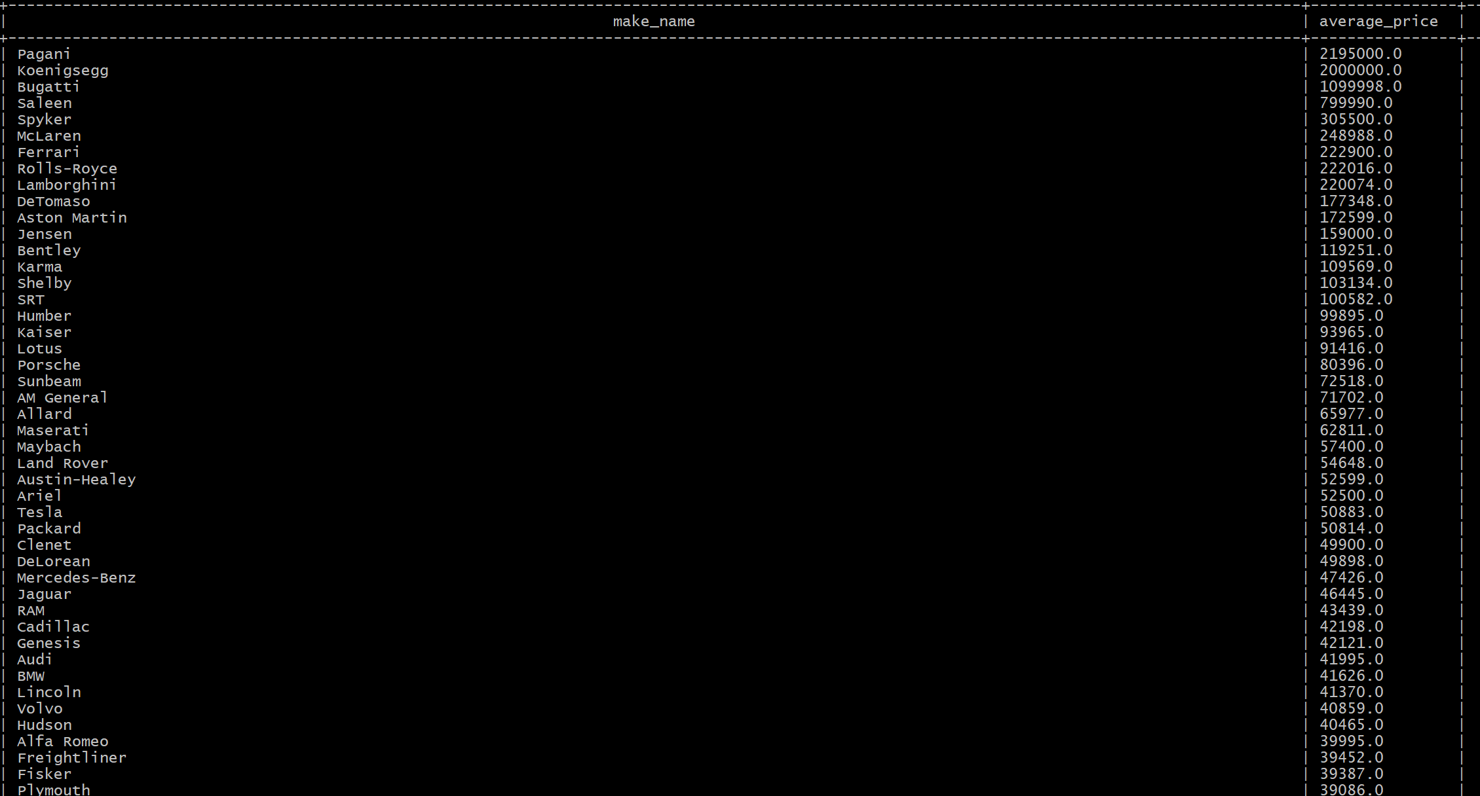
Average PRICE BY MAKE
110 rows selected (277.517 seconds = 4.61 minutes)

Slide 19
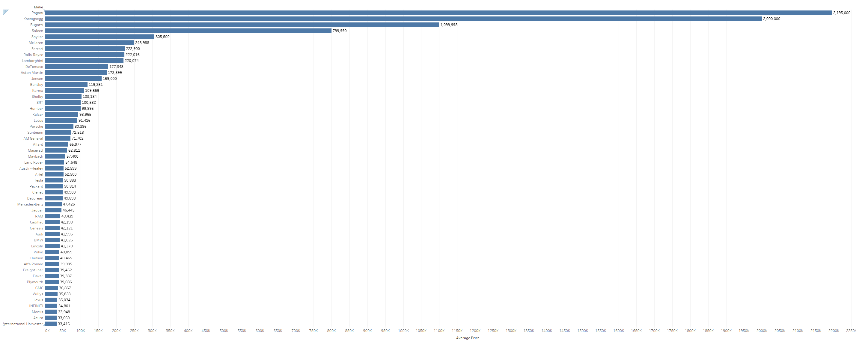
Average PRICE BY MAKE CONT.

Slide 20
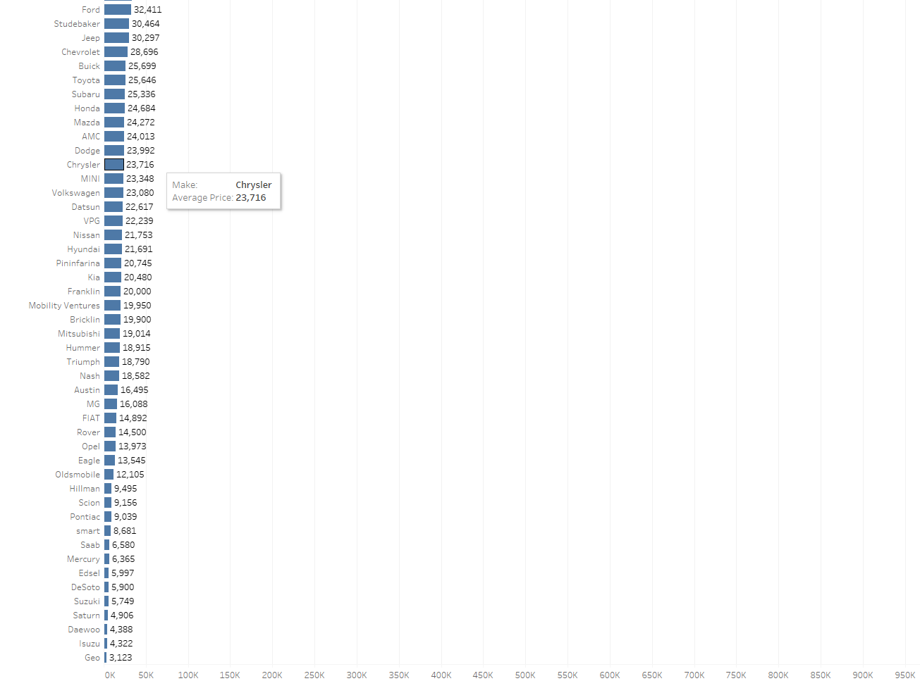
Top 3 average Price -Pagani -Koenigsegg -Bugatti Lowest Average Price -GEO -Isuzu -Daewoo
Average PRICE BY MAKE CONT.

Slide 21
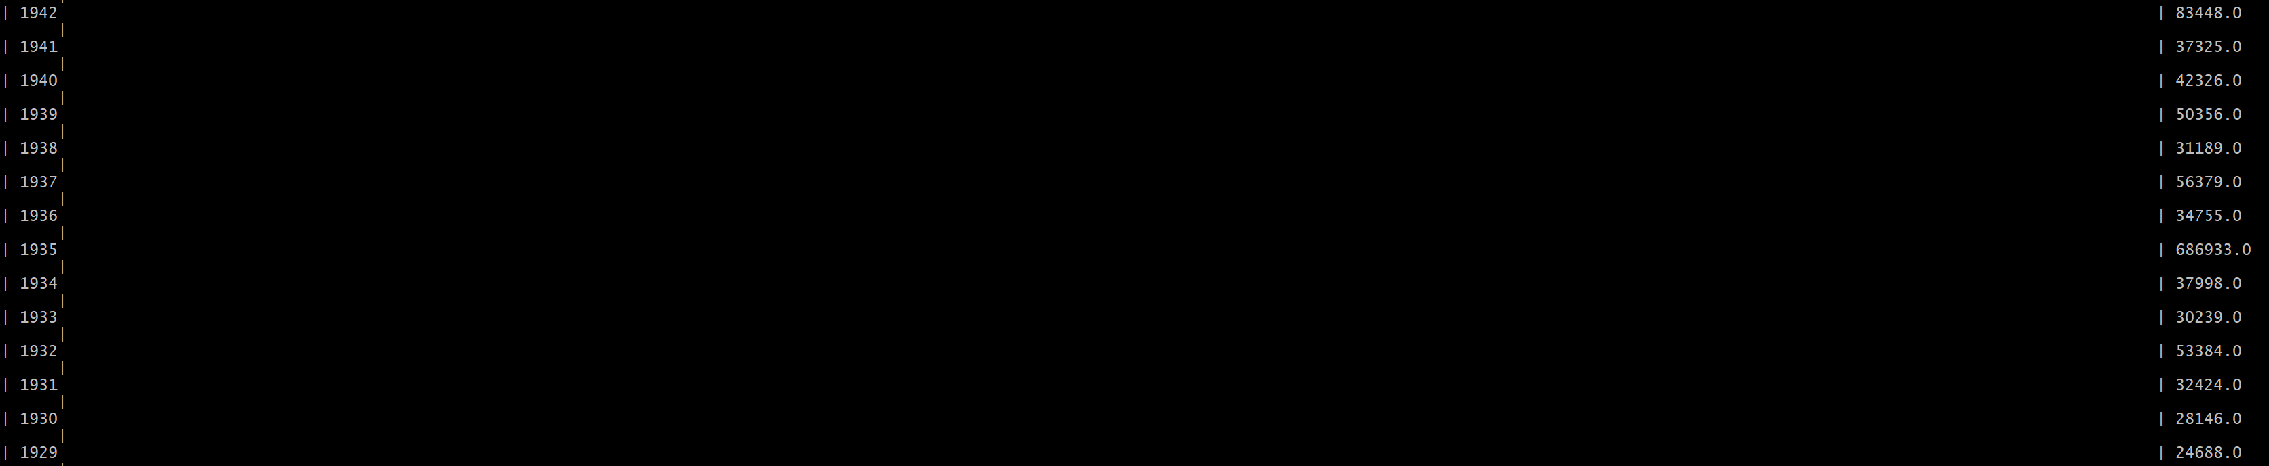
AVG PRICE BY YEAR
106 rows selected (256.639 seconds = 4.26 minutes)

Slide 22
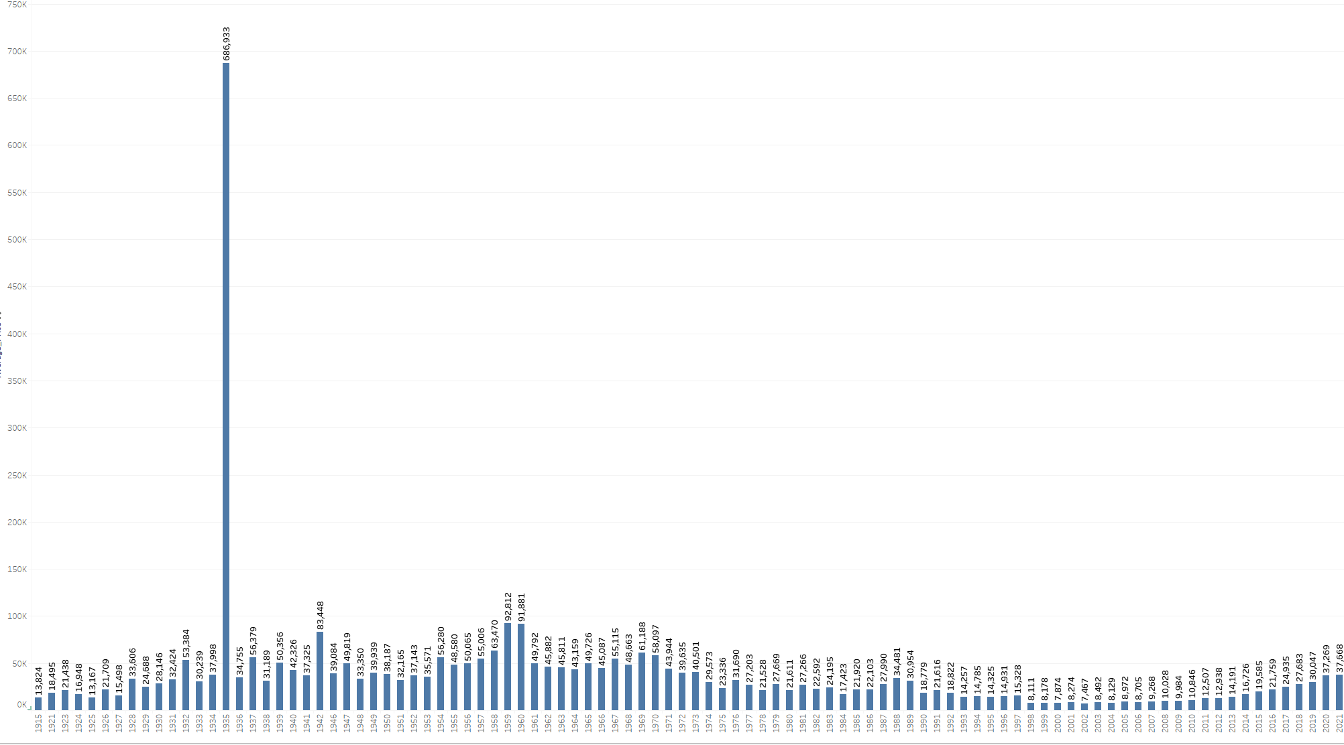

Slide 23
AVG Price BY Year
TOP THREE HIGHEST AVG PRICE
-1935($686,933)
-1959 ($92,812
-1962 ($91,881)
LOWEST AVERAGE PRICE BY YEAR
-2002 ($7,467)
-2000 ($7,874)
-1998 ($8.,111)

Slide 24
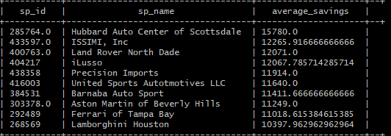
Average Savings Per Seller
SELECT sp_id, sp_name, AVG(savings_amount) AS Average_Savings FROM usedcartestfinal
GROUP BY sp_id, sp_name
ORDER BY Average_Savings
LIMIT 1000;
Total Rows: 1,000 selected
Query Size: 40 KB
Time Taken: ~ 5 minutes (287.584 seconds)

Slide 25
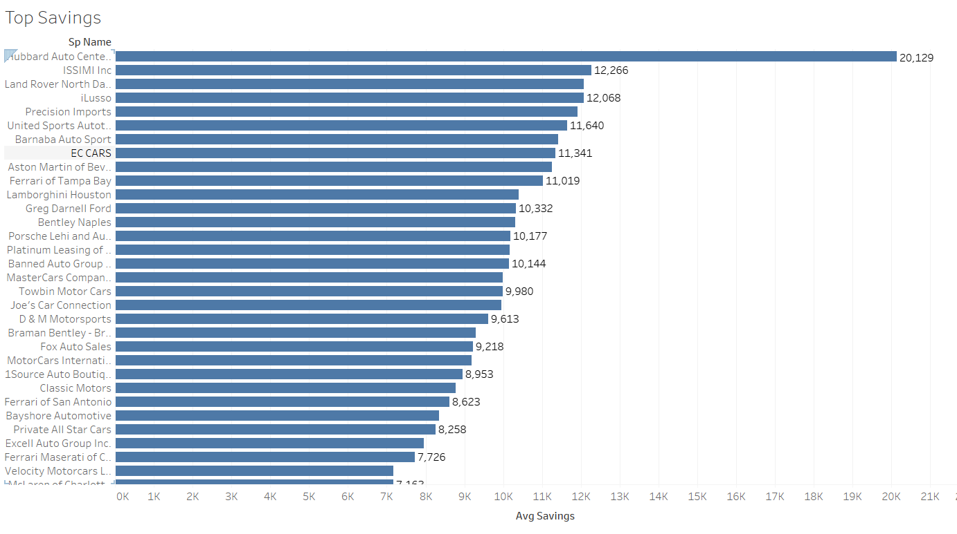
Average Savings Per Seller (Top)
Key Findings:
Hubbard Auto Center of Scottdale – $20,129
Total Average Savings - $3302.02
More Disparities Between Sellers

Slide 26
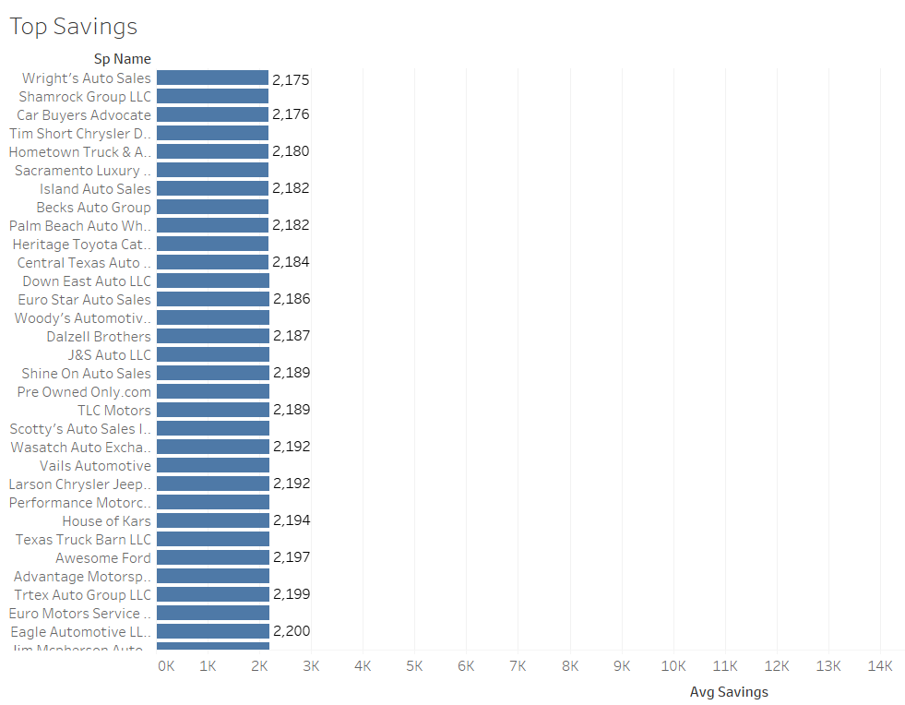
Average SAVINGS PER SELLER (Low)
Key Findings:
Wright’s Auto Sales – $2,175
Less Disparities Between Sellers
Median - $2773
Mode - $2264

Slide 27
How to improve our analysis
Do Diagnostics – Check to make sure the errors are normally distributed.
Check for Outliers – Each of these affects the accuracy of our results
Check for Interactions – An interaction of Change in Price (increase/decrease) by (x) car on average
Query the results for each state to project a better understanding of markets within the area

Slide 28
Final Takeaways
Good luck haggling the dealer down - Car dealerships don’t usually make that much on the car but make their money on warranties and fees. Your best chance is to haggle on the deals being offered (terms and agreements).
Don’t get the powertrain warranty - This is like the “french fries” of the auto industry. Pure profit.
Every dealership has quota - Going in at the end of the month might help you, but the dealership will be packed.

